Slide 1




NFL Injury and Draft Success Prediction
Kelly He, Philip Rex Peters, Samuel Williamson, Tinkle Jain, Saswata Chakraborty
Notes:
I don’t think I need to talk about the popularity of American football to everyone here, but do you know there are estimated 1.2 M football related injuries reported every year, some of which include severe lower body injury and brain injuries including CTE Chronic Traumatic Encephalopathy. Due to the severe contact nature of the sport, football has become one of the most injury prone sports in the country. This is why it very important to understand factors related to the origin of the injuries and to help mitigate them to improve player safety and career longevity.
Hello everyone,
My name is Saswata Chakraborty, and I am representing Team 7. Our topic of discussion today is on National Football League Injury and Draft Success Prediction. Joining me in this presentation today are my team members, Kelly He, Philip Rex Peters, Samuel Williamson, Tinkle Jain.
Next slide

Slide 2

SAS
OBJECTIVE
Predict NFL player injuries
Predict draft success
Identify patterns and factors contributing to player injuries based on historical data
Develop predictive models to assess likelihood of injuries, mitigating risks and optimizing player management strategies.
Utilize NFL Combine metrics from a separate dataset to predict the likelihood of players being drafted
Assist teams with decision making by correlating metrics with player performance and career longevity
Notes:
Our project involved addressing two important aspects of NFL, first was on player injury and second was around drafting. For the first one, our goal was to analyze historical data to find patterns and factors that contribute to player injury and then build a predictive model that would help assess player injury likelihood, resulting in improved player safety and management.
Our goal for player drafting also followed similar strategy in which we analyzed historical data and build predictive models enabling improved player selection process based on performance and player longevity. I will now give the floor to Kelly to share the next part.

Slide 3
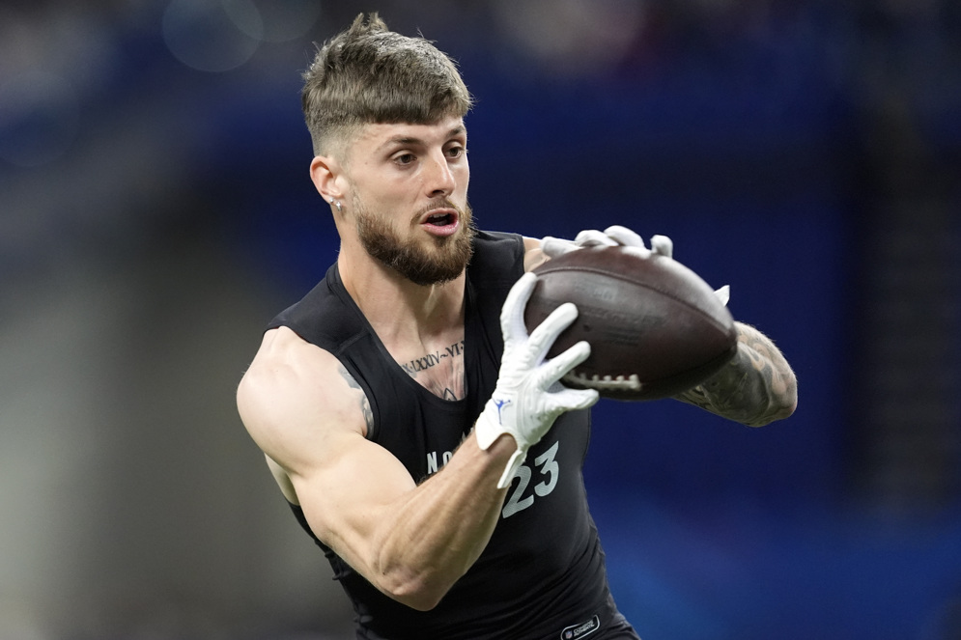
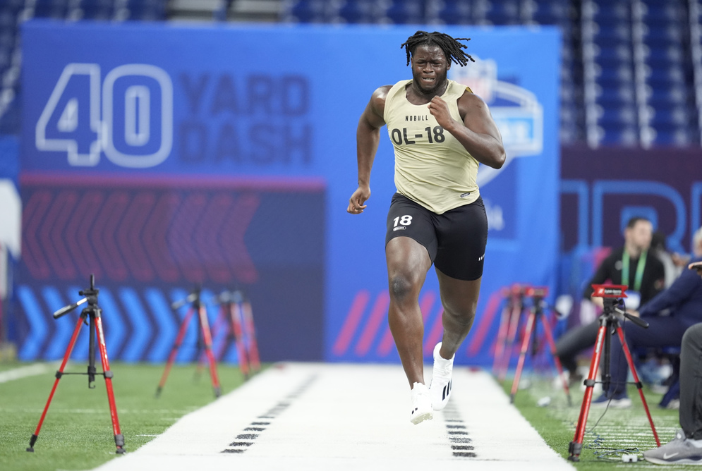
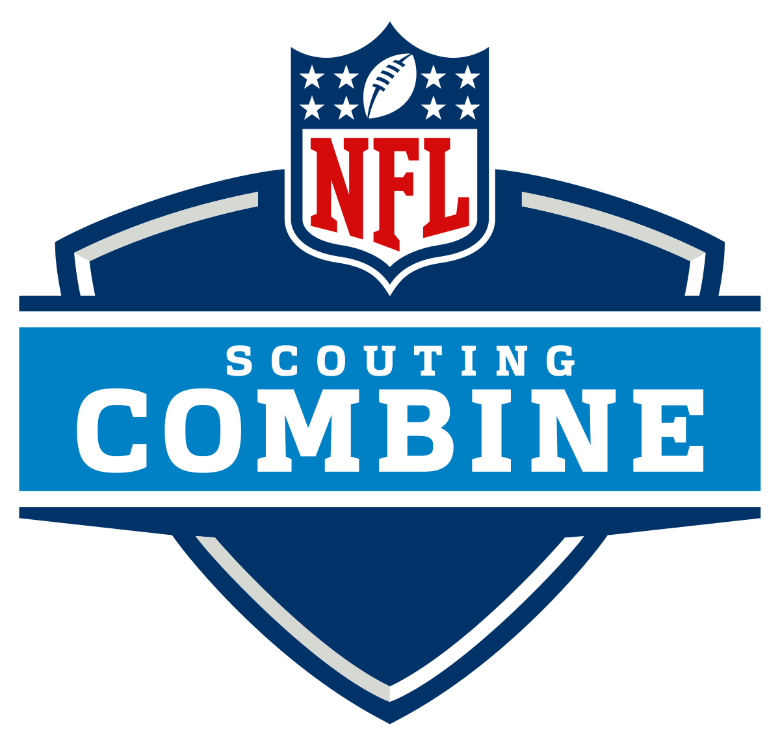
KELLY
INTRODUCTION
FOUR DAYS
INVITE ONLY
300-355 COLLEGE PLAYERS
Notes:
Using machine learning to predict likeliness of injury and draft to optimize performance

Slide 4
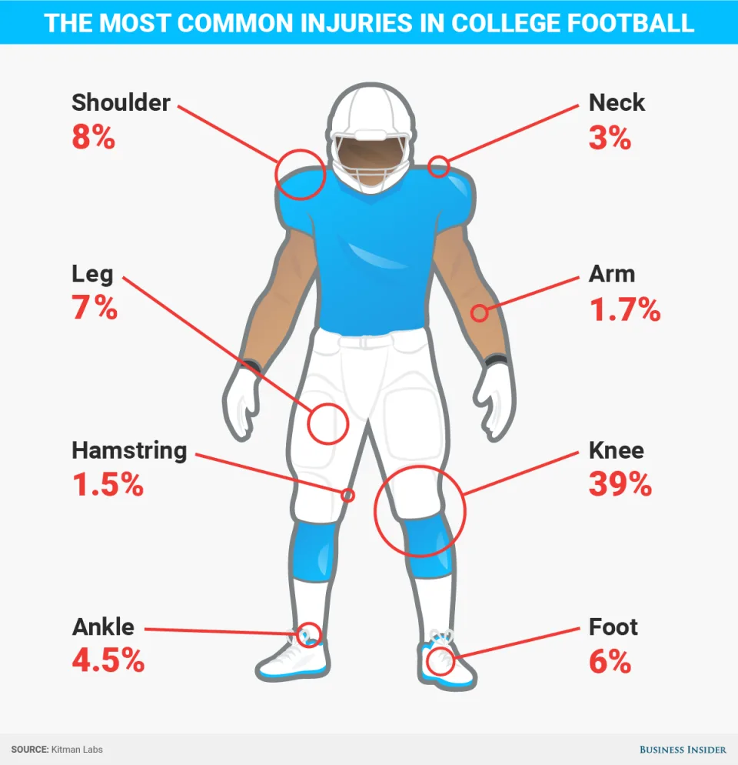
KELLY
?
?
PREVENT INJURY
40-yard dash
Bench press
Vertical jump
Broad jump
20-yard shuttle
Three-cone drill
60-yard shuttle
?
?
INCREASE DRAFT CHANCES
SUCCESSFUL NFL CAREER
Notes:
Players execute intensive drills to showcase their athletic ability testing speed, agility and reaction time. These activities include [ ] and create great risk for injury, which could hinder the career of a prospective college athlete or jeapordize their health. To help minimize risk of injury, our team built a machine learning model to identify patterns and predict the severity of risk based on player stats. Doing so not only benefits the athlete in safety measures, but also contributes to greater chance at draft success.

Slide 5

KELLY
DATA SOURCES
01
02
03
Injury Record
PlayList
NFL Combine
105 injury records
100 unique players
Key columns: ‘PlayerKey’, ‘GameID’, ‘PlayKey’
28 PlayKey values missing
250 players
5,712 games
267,005 plays
Key columns: ‘PlayerKey’, ‘GameID’, ‘PlayKey’
3,476 unique players
2009-2019
Key columns: ‘Drafted’, ‘Player_Type’, ‘Position_Type’, ‘Age’, ‘School’
Notes:
We used three data sources from Kaggle. Mostly focuses on lower body injuries that occur.

Slide 6
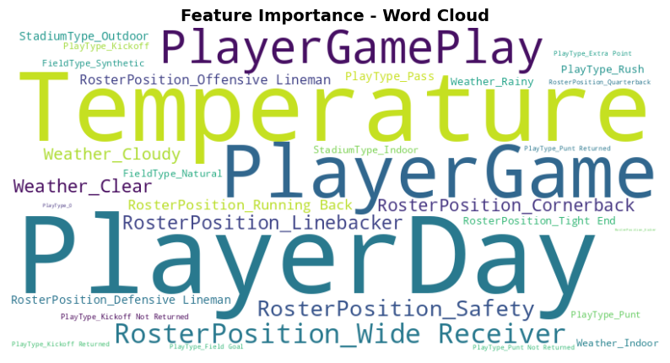
TINKLE
FACTORS LEADING TO INJURY
Notes:
Thank you Kelly! As Kelly mentioned Injury prevention is a critical concern in the NFL . A lot of factors influence the risk factor in an injury. The given dataset helped us to analyze the playing conditions like field type, weather, and temperature along with the various plays of every single player along with their movements, position, turf, speed etc. Through our analysis, we identified key risk factors, including player position, workload, and game conditions. We found that high-impact plays, frequent gameplay without sufficient recovery, and specific movement patterns increase injury risk. By understanding these trends, teams can implement better training, load management, and recovery strategies to minimize injuries and enhance player longevity.

Slide 7
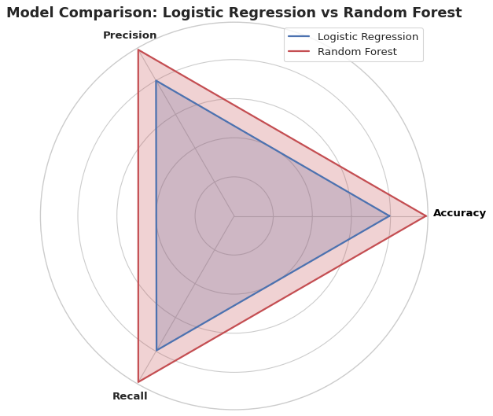
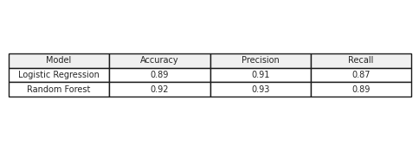
MODELS
TINKLE
Notes:
Our Classifier takes into account all these factors to predict about the body part most likely to be injured so that the players can take prior measures in order to prevent it. To predict injuries, we developed machine learning models using historical game and injury data. The process began with data preprocessing—cleaning missing values, feature selection. We tested Logistic Regression and Random Forest model to determine the best balance of accuracy, precision, and recall. Among them, Random Forest proved to be the most effective in predicting injuries due to its ability to capture complex patterns in the data.
By training these models on past injury patterns, we can estimate the likelihood of injuries occurring in real-time scenarios, helping teams take preventive measures before an injury happens.

Slide 8
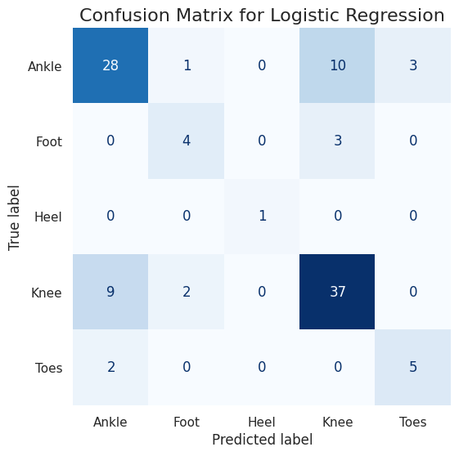
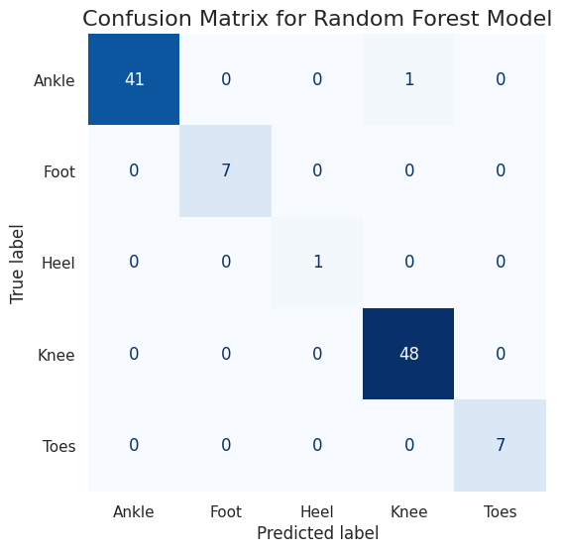
TINKLE
INJURY PREDICTION MODEL
Notes:
Here we compared Logistic Regression and Random Forest models.
Logistic Regression is a simple, interpretable model, but its performance is suboptimal.
Misclassifications:
Many "Knee" injuries were predicted as "Ankle."
"Foot" and "Toes" injuries have moderate misclassification.
Conclusion: Logistic Regression struggles with complex injury classification.
Whereas Random Forest Model
A more robust, ensemble-based method that handles nonlinear patterns well.
Key Improvements:
More accurate predictions across all injury categories.
No misclassification in "Knee" injuries.
Better performance for "Ankle" and "Foot" injuries.
Conclusion: Random Forest significantly outperforms Logistic Regression.
And is better choice for this task due to its improved accuracy.
Passing on to Philip for discussing drafting

Slide 9
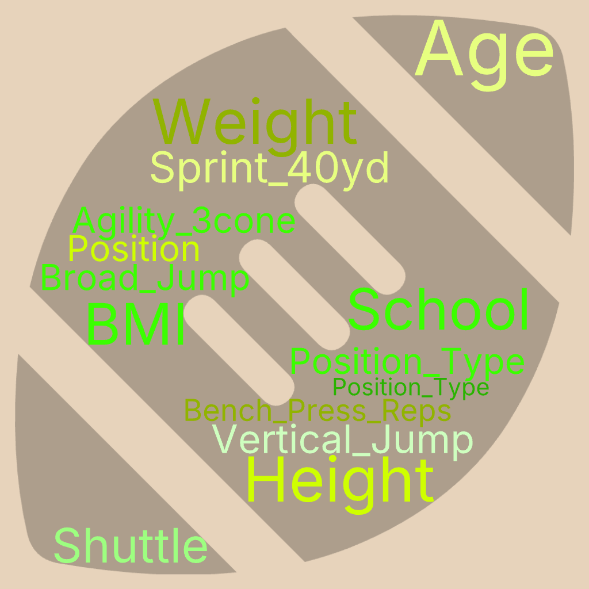

PATTERNS AND FACTORS FOR DRAFT SUCCESS
PHILIP
‘Drafted’
Outcome Variable (y)

Slide 10
PHILIP
METHODOLOGIES FOR
DRAFTING PREDICTION MODEL
Data Preprocessing
Cleaning
Missing values
Outliers
Feature Engineering
Selecting & removing columns
Binning
One-Hot Encoding
Get_dummies for non numerical data
Scaling
Normalize the values of features
Machine Learning
Model Selection
Model Training and Optimization
Data splitting
Model Tuning
Model Evaluation
Accuracy → Overall correctness
Precision & Recall → Important for imbalanced datasets
Notes:
Key Reasons for Using a Neural Network:
High-Dimensional Input Handling: With 120+ features, a neural network can process large amounts of structured data effectively.
Non-Linear Relationships: Draft position depends on multiple factors like speed, strength, experience, and team needs, which interact in non-obvious ways that neural networks can learn.
Feature Interactions: The model can automatically learn how different metrics combine to influence draft stock (e.g., a quarterback's arm strength vs. a lineman's weight).

Slide 11
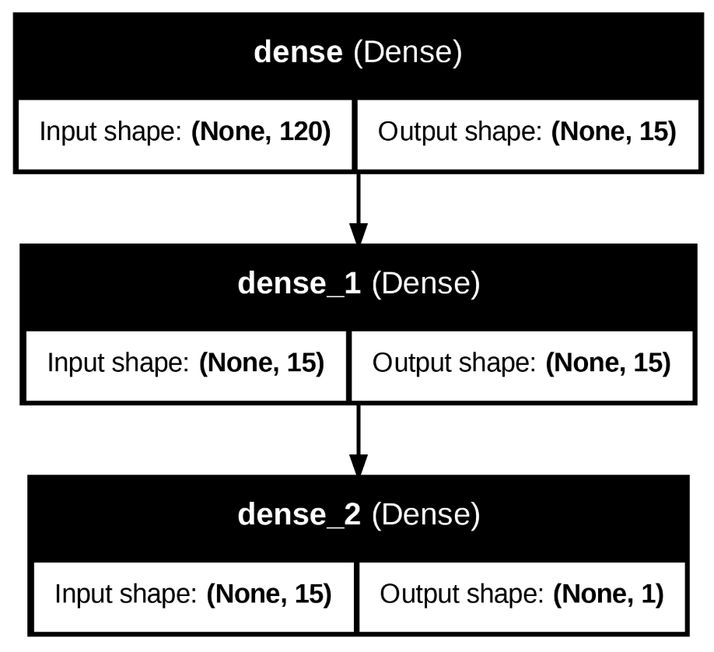
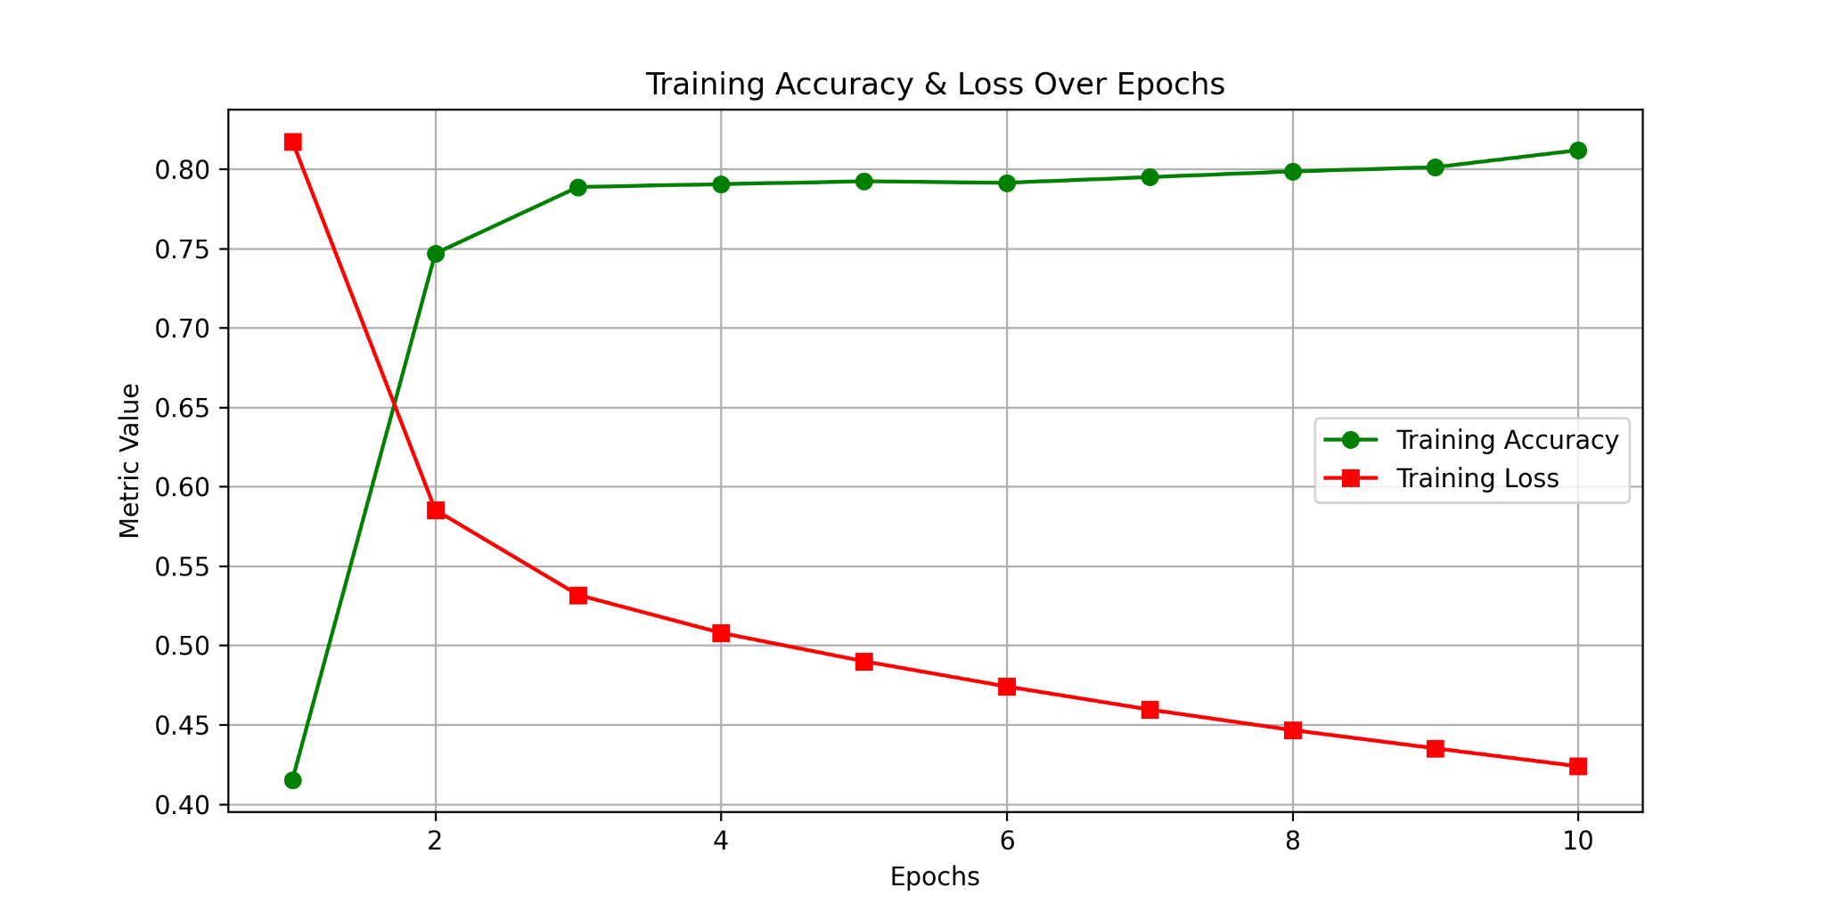
NEURAL NETWORK
PHILIP
DRAFTING PREDICTION MODEL
Accuracy | 0.7787
Loss | 0.5298
Notes:
120 input features → 15 neurons (Layer 1) → 15 neurons (Layer 2) → 1 output neuron.
Uses ReLU activation for hidden layers and Sigmoid activation for the output layer.
Accuracy Increases, Loss Decreases
The model is correctly adjusting its weights during training.
It is minimizing the error between predictions and actual values (lower loss).
More correct predictions over time result in increasing accuracy.
Ultimately, on the test set, the model achieved an accuracy of 77.87%, meaning it correctly predicted draft success approximately 78% of the time, while the loss of 0.5256 indicates the average error in its predictions based on the chosen loss function

Slide 12
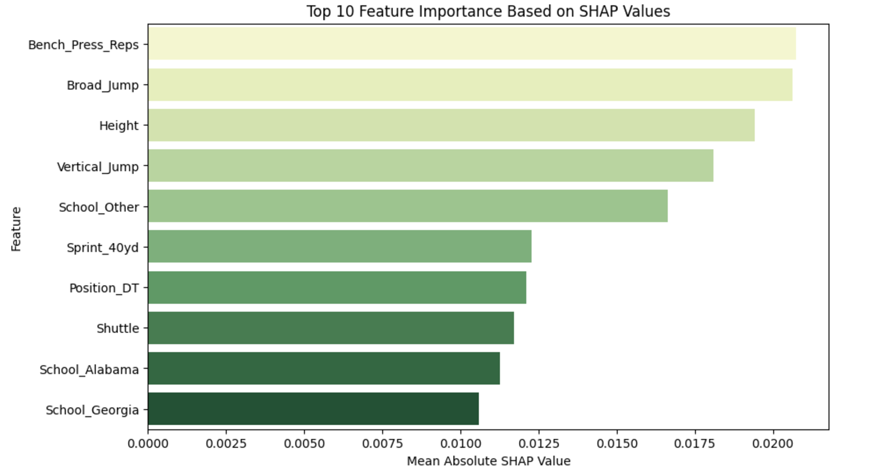
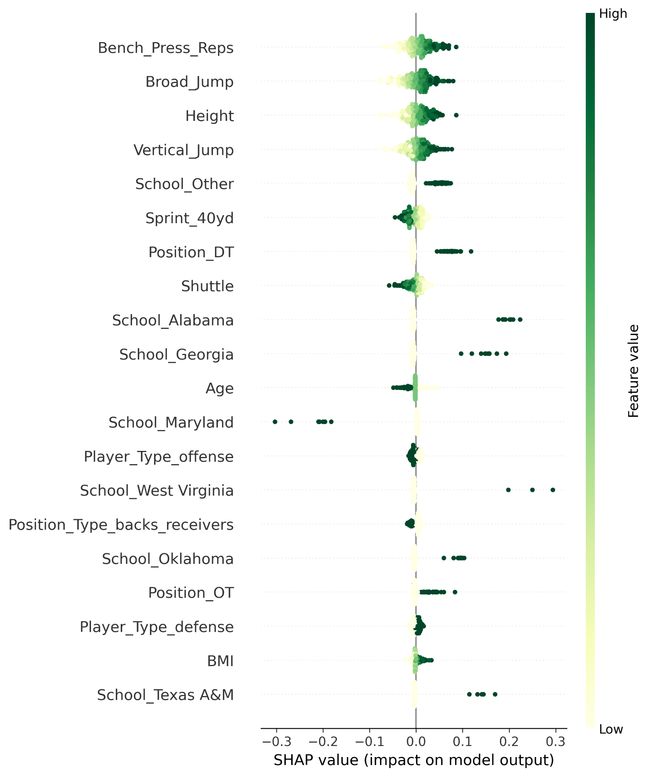
DRAFTING MODEL FEATURE ANALYSIS
SAM
Notes:
After running our Draft Prediction model, we wanted to see what factors contributed most to the accuracy of the model like we were able to do with the feature_importances code usable with Random Forest models. We did some online research, and found a new import package called shap, which is a game theory approach to explaining the output of a ML model. This import package found that bench press reps, broad jump, and height were most critical in determining if a player would be drafted or not.

Slide 13

CONCLUSION + FUTURE RESEARCH
SAM
INJURY
Predicting when an injury is likely to occur is possible with machine learning models, which will help insure better player safety going forward
DRAFTING
Predicting when teams will draft players, just based on their combine statistics, is also possible with ML models
OVERALL
Machine learning will strongly contribute to the future of sports predictions going forward, with much more opportunity to explore what can be predicted
Notes:
In conclusion, Machine learning models proved to be effective in predicting injuries and draft results with the data we found, and were able to show us what factors contributed more heavily to an injury occurring or a player being drafted. Being able to predict outcomes is huge in sports, whether it be for players to stay safe, for coaches to have better strategy, for GM’s building better rosters, or for sportsbooks and bettors to have an edge in sports betting. Our project shows the beginning of what is possible with ML in the sports landscape, but is just the tip of the iceberg.

Slide 14
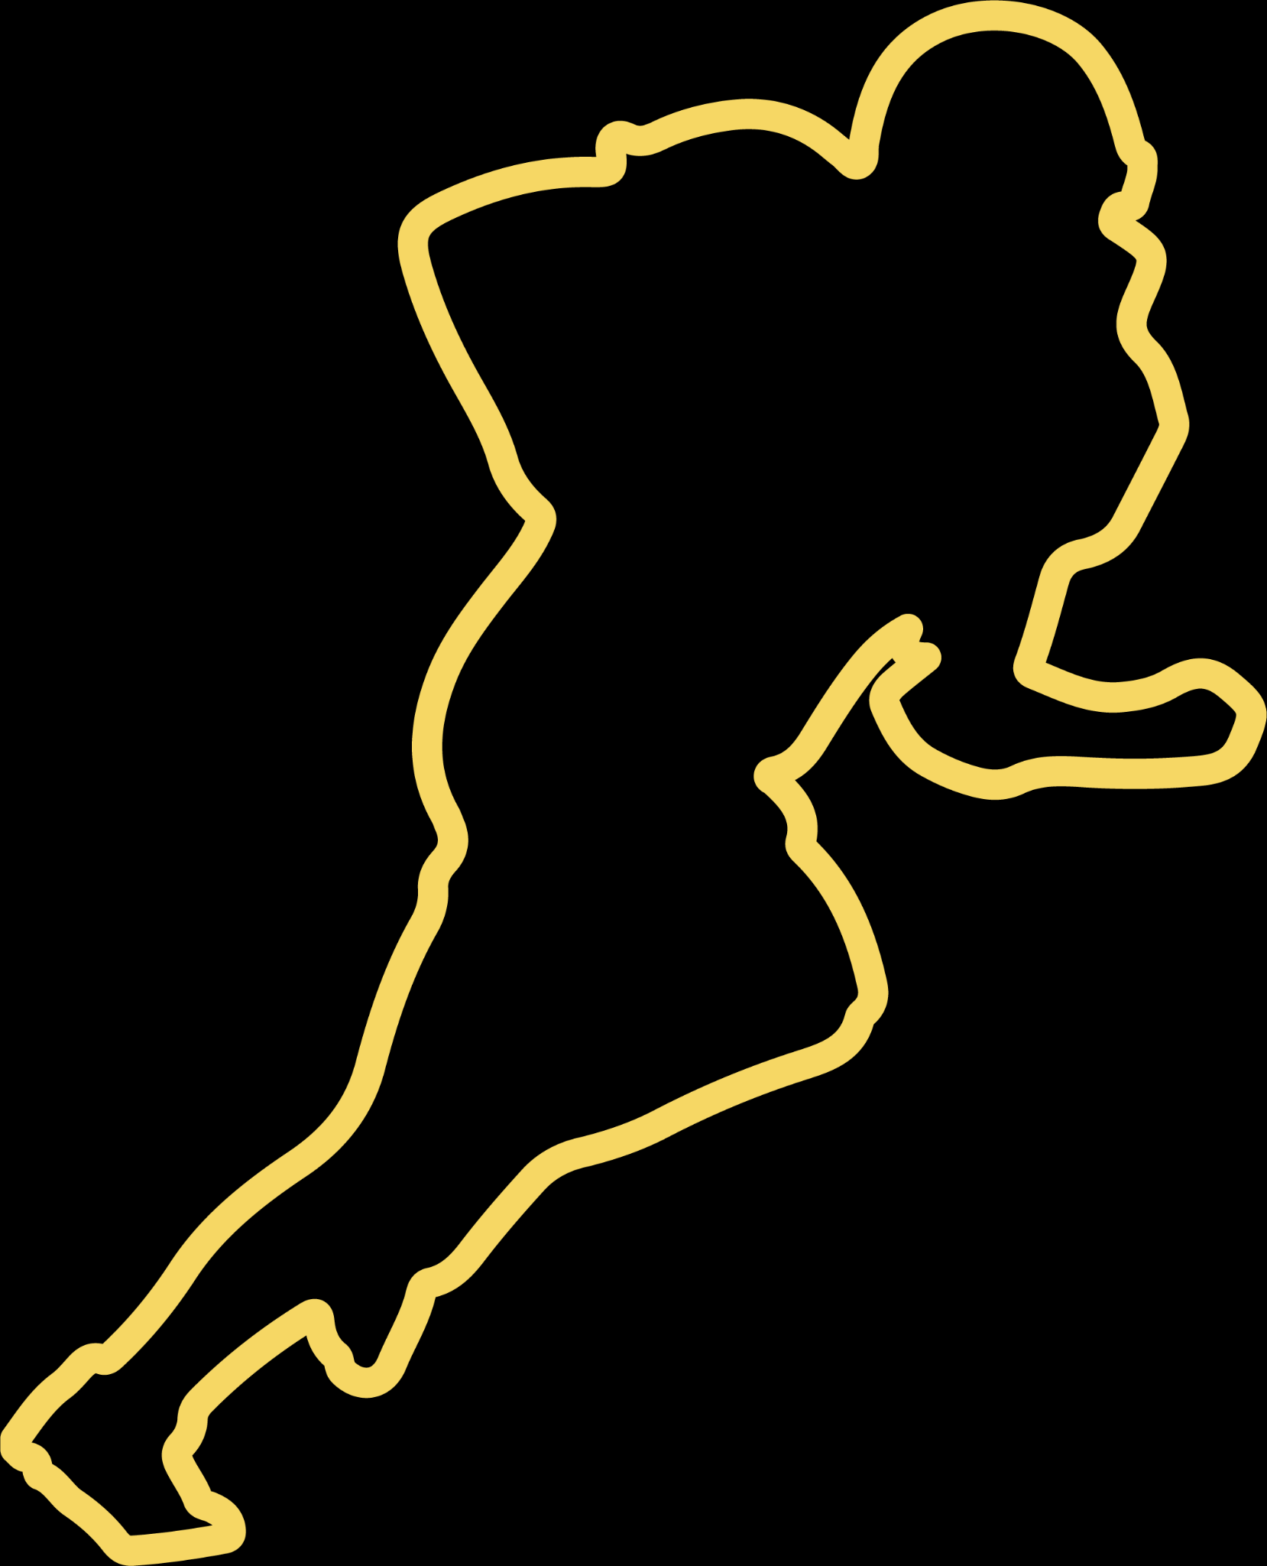
THANK YOU

